Slide 1
IS LOVE PREDICTABLE? By: Felix & Lieke

Slide 2
Goal of project:
Predict whether two people who go on a speed date with each other are a match based on different features

Slide 3
OUR PRESENTATION
Input
Demo
Modeling
Conclusion

Slide 4
Input
Pre-processing of the data
1

Slide 5
Input
Research by Columbia Business School
310 unique participants, 129 dimensions
Features: dating results, demographics, questionnaires

Slide 6
Dating Results
Asked whether they want to see their date again→ if both answer yes, it is match → predicted variable in our model
Rate the 6 key attributes: attractiveness, sincerity, intelligence, fun, ambition, shared interests

Slide 7
Questionnaires
Demographics
Dating habits
Self-perception across 6 key attributes
Lifestyle information (interests in sports, museums etc.)

Slide 8
OUR PRE-PROCESS
STEP 1
STEP 2
STEP 3
Data cleaning
Data merging
Feature creation

Slide 9
Step 1: Data Cleaning
Handle missing values → problems with different waves
Remove variables we are not interested in

Slide 10
Stap 2: Data Merging
Match the entries of the two participants who went on a speed date with each other
Delete double entries

Slide 11
Step 3: Feature Creation
Create new variables which indicate the difference between the variable of interest of the two partners, e.g. age difference, interests difference, income difference
→ numerical or dummy

Slide 12
Descriptives
Match | No Match | #Dates
313 | 1648 | 1961
Average Age | Average of Age Difference
26.7 | 3.77

Slide 13
Intentions of the Participants
Goal | Numbers
Seemed like a fun night out | 39%
To meet new people | 40%
To get a date | 9%
Looking for a serious relationship | 4%
To say I did it | 5%
Other | 3%

Slide 14
Key Attributes
 | Females about partners |  | Males about partners
Key Attributes | Match | No Match | Match | No Match
Attractiveness | 7.0 | 5.75 | 7.41 | 6.19
Fun | 7.7 | 6.0 | 7.52 | 6.27

Slide 15
Modeling
Support Vector Machine
10 Fold K-Cross Validation with parameter Tuning
2
Train-Set: 80% | Test-Set: 20%
1568 Obs x 129 Dim | 393 Obs x 129 Dim

Slide 16
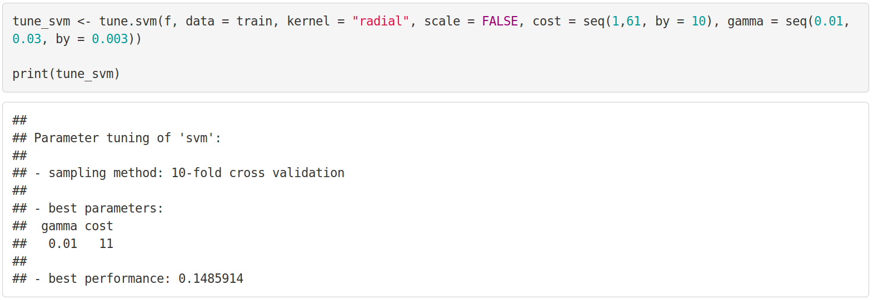
Demo

Slide 17
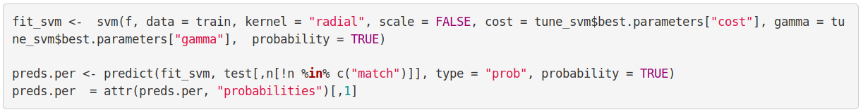
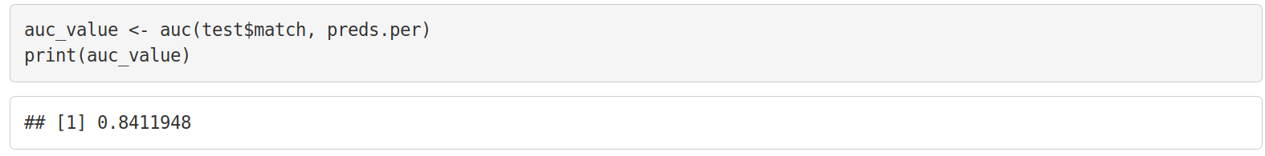
Demo

Slide 18
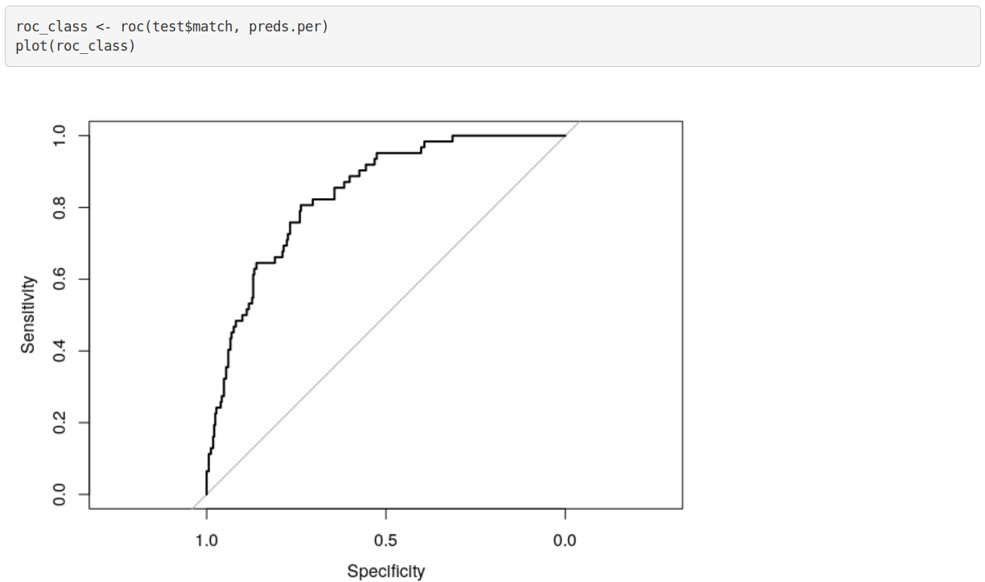
Demo

Slide 19
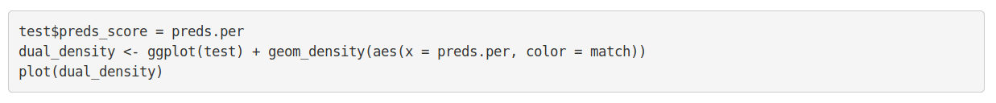
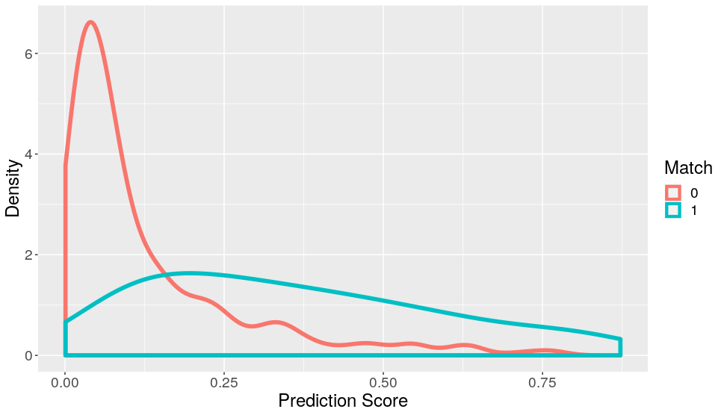

Slide 20
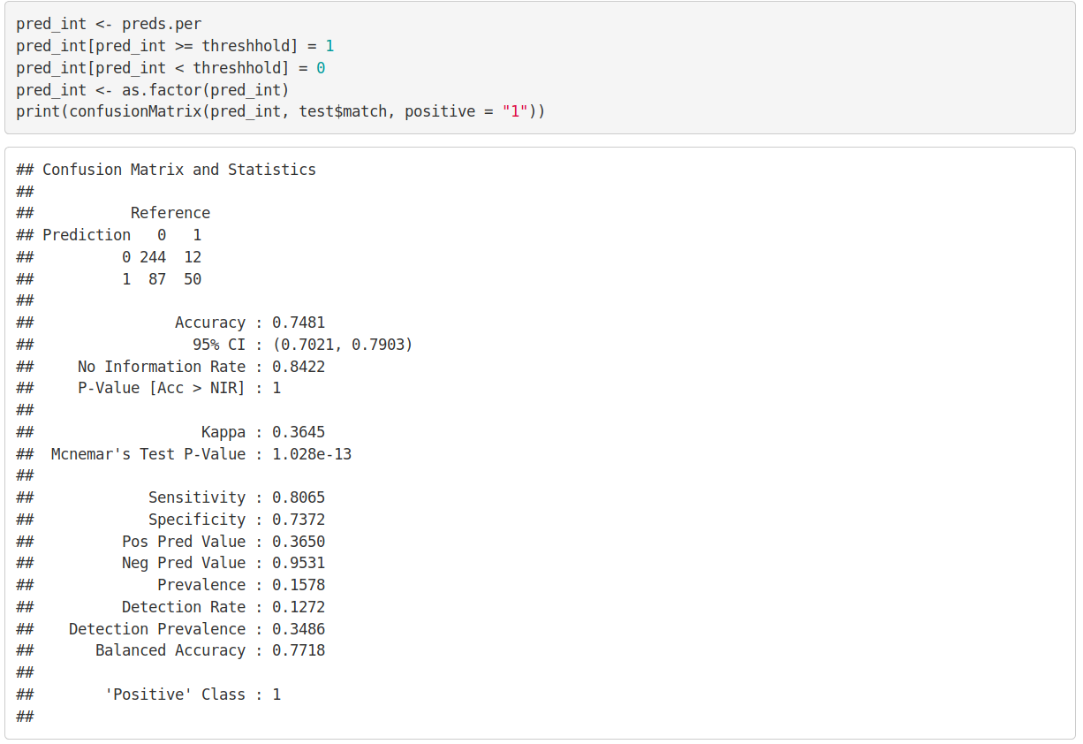

Slide 21
Conclusion and Discussion
Accuracy lower than expected since many variables included
Due to threshold selection, Recall of 80% achieved
Unbalanced Dataset, more data required for better results
For next attempt: Try predicting match before date
What would you include in the next survey?
3

